Slide 1
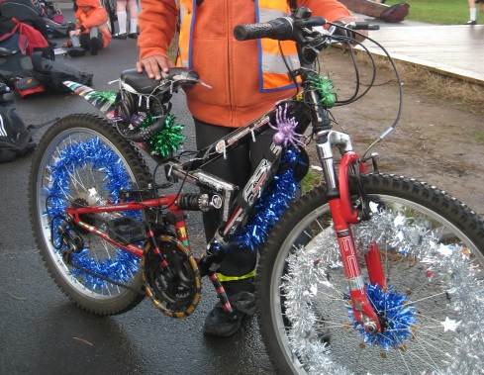
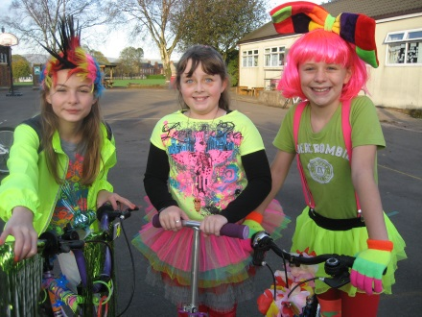
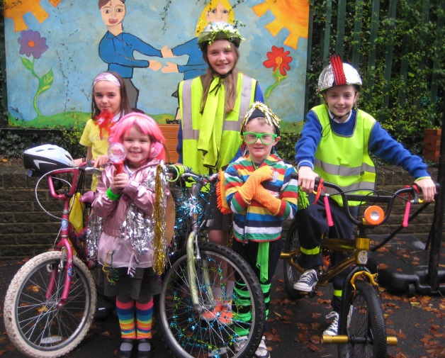
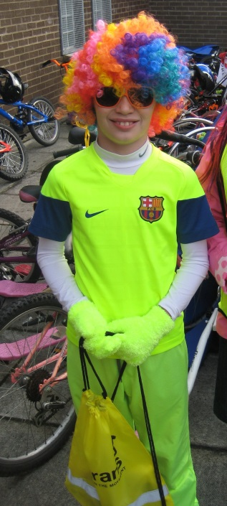
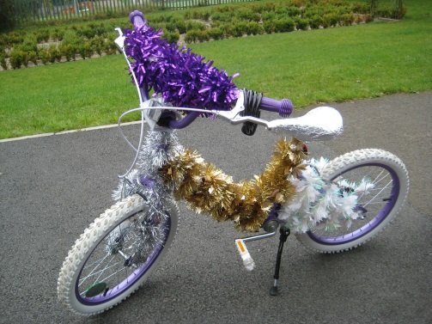
St Jarlath’s PS
Ditch the Dark Day
A special walk, cycle and scoot to school day – you are invited to wear your brightest accessories AND to decorate your bike or scooter!
Tuesday 30th January 2024

